Slide 1
Data
What do we need, and what do we do with it once we have it?
Allyson Rodriguez & Peace Ossom Williamson
Strategic Collections Librarian Director for Research Data Services
University of North Texas University of Texas at Arlington

Slide 2
Interlibrary collaboration
Both institutions benefit from the manpower of collections librarians and public services librarians focused on two sides of data support.
UTA:
Outreach
UNT:
Collections

Slide 3
UNT
UNT
Evaluating and Building Meaningful Collections

Slide 4
University of north texas
Establishing policies and procedures around data resource acquisition
Notes:
Due to the incredible number of requests from liaisons and faculty for data resources, and the ever-expanding number of available resources we knew three things.
1) There is no way we can buy every data resource, but
2) we need to figure out a way to reasonably evaluate and provide resources that cover the necessary areas, and
3) data resources are very different from your typical library electronic resource and had their own considerations.
In response to these needs we set out to do several things,
1) create a collection development policy that could guide our actions when looking to purchase data resources,
2) create a tool to evaluate data resources, and
3) complete an environmental scan to better understand what is out there and do an in-depth analysis to see what changes need to be made in our collection

Slide 5
Evaluation Rubric
Rubrics act as an easy way to document our decisions regarding electronic resources.
Notes:
The rubric acts as an easy way to document our review of each data resource. Saved in each product research folder we can now go back and see documentation regarding our decisions on any given resource we have investigated.

Slide 6
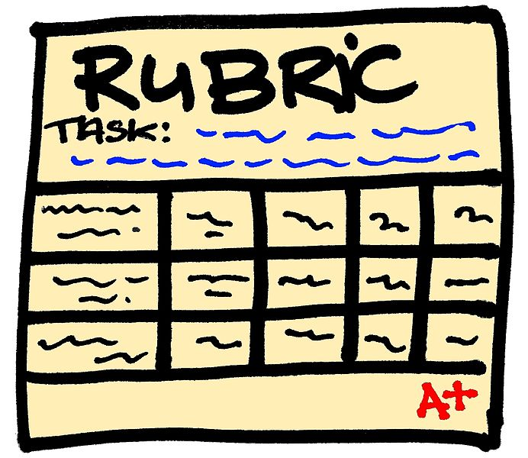
Rubric Elements
Access or Use Restrictions
Chronology
Formats
Metadata
Quality
Substance
Authority
By Cleonard1973 (Own work) [CC BY-SA 4.0
(http://creativecommons.org/licenses/by-sa/4.0)],
via Wikimedia Commons
Notes:
I started by looking at common elements in other university data policies, added in a few from talks with liaisons, and my own research into what makes a good resource. Then simultaneously created a rubric and a corresponding policy.
Access or use: Consider number of users, how is the access provided (IP authentication, individual terminal, etc.), how good is the interface?
Chronology: typically current and historical data will be useful; however, some places only want current data, ask your stakeholders
Formats: Beware of proprietary formats, these will greatly restrict use and the ability to reuse or permanently acquire the data
Metadata: This may be especially important for otherwise freely accessible data, adding quality metadata that increases the discoverability can be a great value add. It’s also important for proprietary data, if your users can’t find it and use it, then why pay for it?
Quality: this should go without saying, but consider the relevant subject areas. Interdisciplinary data will get you more bang for your buck, but are you willing to purchase data for one specific area, one individual? These are all things you need to consider

Slide 7
Rubric Elements Cont.
Usability
Confidentiality
Tutorials or Guides
Licensing or Copyright Concerns
Especially Public Domain Data
Other areas:
Usage Statistics
Interlibrary loan
Notes:
Usability: This goes hand-in-hand with the metadata, but also constitutes the interface. Consider your user. Is your user typical mostly undergraduates, graduates, faculty?
Confidentiality: If data contains information confidential in nature or comes with personally identifiable information consider it carefully before collecting or hosting the data. If you are hosting it you are responsible for the security of the data. This is not something to be taken lightly. Individual researchers are always welcome to collect and store this data on their own. Many times researchers are better able to individually contact the creator of the data and store it more safely.
Tutorials: One issue our users often face is they do not know how to import or export certain files types of data. If a resource has good tutorials or guides as to how to complete this it can be very useful and another great value add
Licensing or Copyright: This is always an issue. Be sure you understand the implications of any contract you sign regarding the data you purchase or subscribe to. Sometimes vendors will place restrictions on public domain data because it was found through their platform. Be aware of this and look carefully through your contracts to be sure you know whether or not these restrictions are in place
Other areas: These may not be deal-breakers, but are definitely things to consider and push back on with vendors. Many data resources are not necessarily made with academic institutions in mind so they may not have any policies or procedures in place for things like providing usage statistics or loaning the data to other institutions, but these are things that are typically important to libraries. You may have to do some vendor education with things like this.

Slide 8
Collection Development Policy
The policy acts as an outward facing explanation of our internal processes.
Notes:
The policy acts as an outward facing explanation of our internal processes. The policy was meant for public consumption and will hopefully become part of our overall collection development policy.

Slide 9
Policy Elements
In addition to the Rubric Elements:
Language
Geographical Area
Other things to consider:
Interested areas
What is your focus? Students or Faculty?
Will you allow for exceptions?
Notes:
I also included a narrative about the importance of data, but explained some of the restrictions and issues libraries face when acquiring these resources (i.e. high prices, great number of options, etc.)
Geographical area: especially consider the emphasis at
your institution, we have a heavy local focus, not just Texas, but specifically Denton, be cognizant of your institutional needs
Language: Consider whether or not you will accept
Exceptions: use language like “case by case basis” or “we prefer”

Slide 10
Data Resources
An environmental scan of items owned, subscriptions we do not own, and Open Access or freely available to understand the data resource landscape
Notes:
After creating the draft policy and rubric I began searching for resources to complete the environmental scan. I started with an excel spreadsheet.
For internal purposes I created 4 tabs, one for resources we currently own, one for subscriptions that we do not own, one for OA or freely available, and finally a tab with a legend. I quickly discovered when I was trying to include the subject areas covered by some of the resources this would not be easy, so I created general subject categories that could cover these areas and make it easier to show overlap.
Within each tab I created columns for the name of the resource, cost, URL, access type, formats available, subjects, where they pulled their data from, whether the original data is proprietary or freely available, ease of use or added benefits, and a section for notes.
For each resource I, with the help of a student worker, Denise, I researched each of these areas. Some are not easy to find, or publicly available at all. Many paid resources do not necessarily indicate where they pull their data from, or if it is only proprietary data. I’ve just completed this portion and plan to contact vendors to see if they will share where their data comes from. This will help us understand if we are looking at proprietary data that we can only get through the resource, or if we are paying for an interface. Which, to be fair, we are willing to consider paying for a more usable interface if the original data is difficult to work with, lacks metadata, or is not discoverable for most users.

Slide 11
How to find resources
Ask
Liaisons/subject matter experts
Fellow Librarians
Use listservs and other resources
Search other libraries’ catalogs or LibGuides
Conferences and vendors
Ask me
Notes:
Don’t be shy about asking. Usually people are more than happy to give you their two cents on resources or at least let you know what they subscribe to

Slide 12
Data Resources (Freely Available)
Data Explorer
MatWeb
IMF
Global Health Observatory Data Repository
EM-DAT
Data.gov
Datausa.io
American Fact Finder
TIGER
EJ Screen
Stats America
TNRIS
Geospatial Data Gateway
FAO Geonetwork
Asian Development Bank
County Business Patterns
Federal Reserve Archive (FRASER)
National Center for Health Statistics
UN Data
World Bank Open Data
OECD Statistics
Correlates of War Project
Union Membership and Coverage Database
American National Election Studies
So many more...
Notes:
As you can see here, there are plenty of data resources that are open access or freely available. However, some of these are not necessarily the easiest to use (Census data…) but many of these resources understand this weakness and are working toward improvements.

Slide 13
Data Resources (Paid)
Mintel
Euromonitor International
Reference USA
Statista
SimplyMap
I/B/E/S
WGSN
Gallup Analytics
World Market Intelligence
Data Planet
iPoll
CQ products (i.e. Voting and Elections)
Hoover’s Online
Wharton Research Data Services
Social Explorer
Million Dollar Database
Landscan
Standards and Poor NetAdvantage
Foundation Center Database
Hotel Horizons
Mergent
Voxgov
Social Science Electronic Data
RealtyTrac
Rand State Statistics
Technomic
Data Citation Index
Again, so many more...
Notes:
Just a note, we do not endorse or express preference for any of these resources. This is purely to give an idea of the sheer number and variety of data resources available.
Now that we have a list of resources, and some basic information about each, I will attempt to compare like to like, and discover what we actually need, and if we have all areas covered.

Slide 14
UTA
UTA
Building Expertise and Service Models

Slide 15
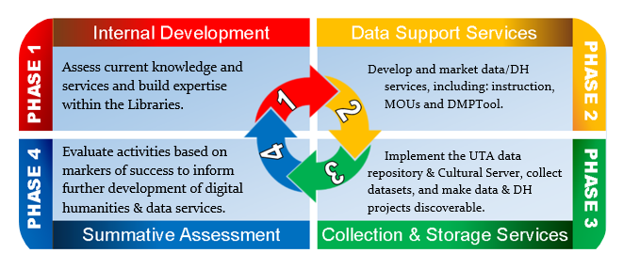
University of Texas at Arlington
Establishing public services around data
Image from Visnak, K., Ossom Williamson, P., & Mirza, R. Description of phases in implementation plan. Digital Scholarship Overview. Last updated July 2016.
Notes:
At UTA, Peace is working collaboratively with colleagues in the Division of Scholarly Communication to develop services around digital scholarship. Her role with research data services include instruction, consultations, and other support around data management and data visualization.

Slide 16
Phase 1
Focus: The creation of instruction content & building library expertise in data management and visualization in preparation of marketing services to the UTA community.
Internal Development

Slide 17
Phase 1:
Internal Development
The two learning groups set goals focused on data management and visualization. Participants in these groups will provide training for liaisons and front-line staff.
Notes:
Two learning groups
Special sessions: researchers visited and talked about their use of data in robotics and digital humanities (members from both groups attended)
Data management learning group
LibGuide: http://libguides.uta.edu/dmlg
Topics covered:
Entire NECDMC curriculum & some DataOne curriculum (data citing, metadata, DMPs, and more)
DMPTool
Data curation profiles
Funding agency mandates
Data visualization learning group
LibGuide: http://libguides.uta.edu/datavizlg
Topics covered
Dataset 101: Cleaning & Restructuring Data
Program Petting Zoo (learning quick programs like Infogram & Plotly)
Visualization 101: Best practices
Graphing in Excel & Google Fusion Tables
Tableau training
Broader Library Training
Liaisons’ hands-on workshop will be mid-October: Two half-day workshops. Goal: Comfort with language around data services, tools, and technology
Front-line staff training throughout fall: During their big all staff meetings will be a new data topic provided regularly. Goal: Awareness of data services being offered and to whom to refer patrons/

Slide 18
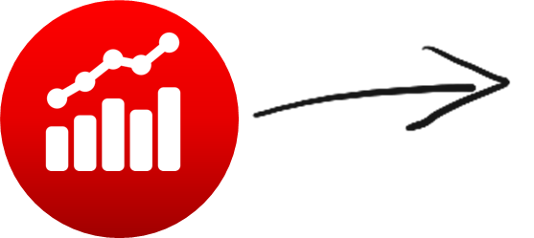
Phase 1:
Internal Development
Data information literacy competencies, first published by Purdue Libraries, were adjusted to include
Levels: emerging, intermediate & expert
Three additional, one removed & two re-defined competencies
Learning outcomes for each
Notes:
The learning outcomes can be pinpointed by faculty and create the structure for customized instruction for their classes.
What are the two additional and two re-defined competencies?
New:
Data awareness and knowledge - understanding the role of data in research
Data responsibility - recognizing and minimizing bias and/or ambiguous or misleading representation in reporting
Data structuring and cleaning - preparing data for analysis
Modified:
Cultures of practice - changed from a competency to a component of each competency
Quality assurance → Data quality and documentation
Metadata → Data description

Slide 19
Phase 2
Piloting training and instruction content for grad & undergrad students and faculty in various disciplines.
Support Services Implementation

Slide 20
Phase 2:
Support Services Implementation
While no broad marketing yet, a) instruction scaffolding in classes and b) workshop partnerships with graduate & faculty training groups are being coordinated for campus.
Pilots for DIL Instruction:
Journalism (undergraduate)
Public Affairs (graduate)
Public Health (undergraduate)
Nursing (doctoral)
Economics (undergraduate)
Notes:
How did y’all choose these particular classes?
Journalism class - I looked at syllabi using UTA’s online system to find classes using data and reached out to 3 professors. I heard back from a professor teaching Data Journalism. She met with me and wants scaffolded instruction around data viz throughout the semester.
Public Affairs classes - I cannot for the life of me remember how I got into contact with this professor. She teaches in CAPPA: the College of Architecture, Planning, and Public Policy. Someone connected me with her. So, I met with her and the library liaison to her department. She also wants several data instruction sessions around data viz in two classes; in her case, it’s for reporting & policy development.
Public Health class - This is a 3-credit semester course (Public Health Informatics) I am actually developing and will be teaching beginning this fall. So, I guess I talked to myself :P
Nursing & Economics classes- Two faculty members are working together on using data viz in their research. As the former primary nursing liaison, I was close with the nursing faculty member. We had a meeting with the three of us and the Economics library liaison. The meeting was around data management in their research project and creating visualizations, but they are also interested in data viz instruction (likely a one-shot) in their respective classes.

Slide 21
Example DIL Competency
Samples from Competency 2: Data Curation & Reuse
Emerging | Intermediate | Expert
Understands how to cite data. Recognizes data’s value beyond original purpose, to validate research or for secondary analysis. | Is able to distinguish between active data and stored data. Develops understanding of the elements in a dataset that are likely to have future value for self or others. | Understands how to make data citable. Identifies potential opportunities for improvements in data curation practices of subdiscipline.
Notes:
Will you make the data competencies, once they’re completed, available to the public?
Yes, I will. I will probably publish them openly at the end of the semester. That will allow me to make a few more adjustments now and after the pilots.
Also, intermediate would include the learning outcomes listed under emerging, and expert would include those listed under emerging and intermediate. I hope that makes sense.

Slide 22
Future Endeavors
Instruction & outreach based on particulars of collections, including promotion of and training for use of open data
Consultations around open access & proprietary variables in datasets
Adaptation & implementation of one another’s projects at our institutions

Slide 23
Please feel free to contact us at
allyson.rodriguez@unt.edu
peace@uta.edu (Twitter @123POW)

Slide 24
References & Resources
American Association of Law Libraries. (2013). Procurement toolkit and code of best practices for licensing electronic resources. Available at http://www.aallnet.org/mm/Publications/products/procurement-toolkit.html
Carlson, J. & Johnston, L. (Eds.). (2015) Data Information Literacy:Librarians, Data and the Education of a New Generation of Researchers. West Lafayette, IN: Purdue University Press.
Collection Development Policy Statement: Data Services (Numeric Data). (2014, August). Retrieved May 03, 2016, from http://libguides.lib.msu.edu/dataservicescollectiondevpolicy
McMaster University. (2010). Collection development policy: Library data service. Available at https://library.mcmaster.ca/maps/Library_Data_Service_Collection_Policy.pdf
Ossom Williamson, P. (2016). Open Data: Options for Researchers. [LibGuide]. Available at http://libguides.uta.edu/opendata
Young, S. (2014). What to do about data? New England Area Librarian e-Science Symposium Poster Session. Available at http://escholarship.umassmed.edu/escience_symposium/2014/posters/6/

