Slide 1


Slide 2
Digitization for Accessibility:
Faculty collaboration, memorandum of understanding, and open access

Slide 3
Presenters
Jeff Downing, Digital Projects Librarian
  downing@uta.edu
Rafia Mirza, Digital Humanities Librarian
  rafia@uta.edu
  @librarianrafia

Slide 4
Project Background
Texas Digital History Collection grant funded through the TexTreasures program
  Collaboration between the Library and the Disability Studies Minor program
Notes:
Rafia: discuss collaboration
Jeff: discuss website

Slide 5
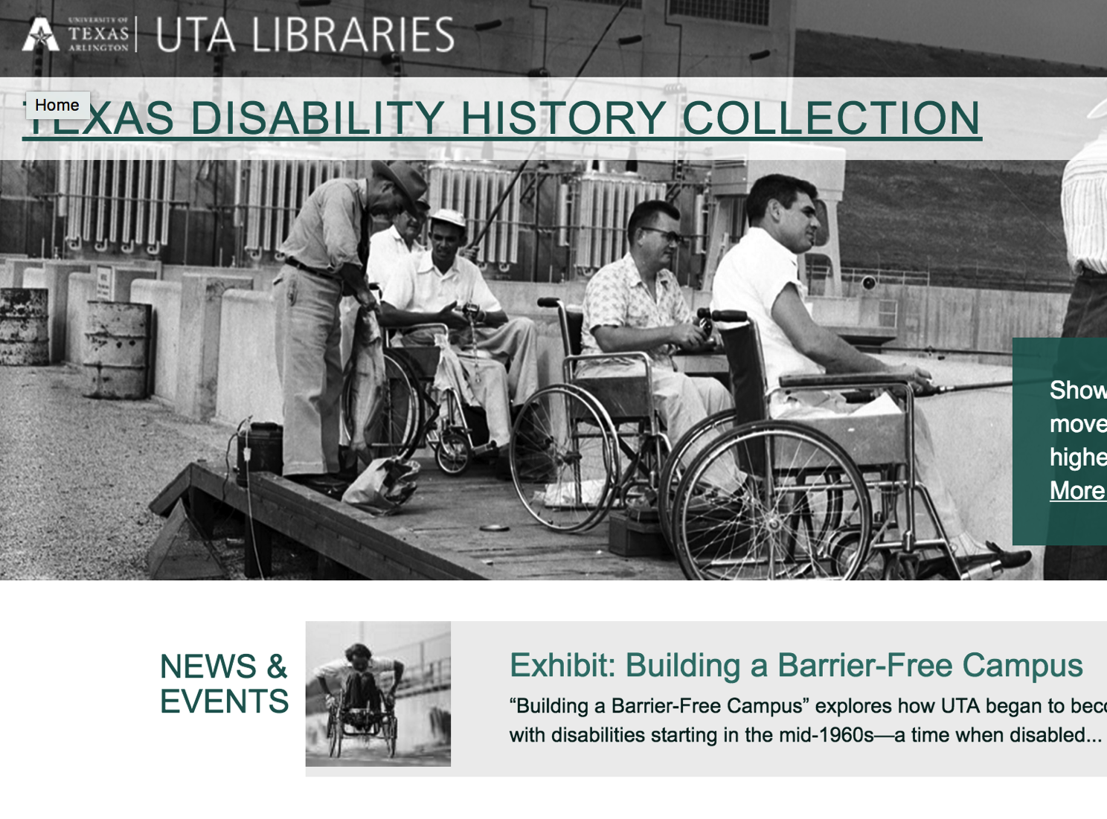
Project Background
  Deliverable is a website containing almost 1,000 documents, images, videos and oral histories representing the developing history of disability rights, particularly at UTA

Slide 6
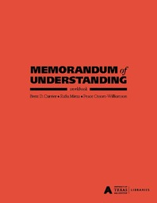
Project Background
  The MOU was chosen as a clear and concise way to describe the responsibilities and schedules agreed to by the participants
Link to Workbook

Slide 7
Building the Texas Disability History Collection
About this website
The Disability Studies Minor’s roles
  Providing oral histories interviews and associated transcripts
  Contributing to the site’s taxonomy
  Reviewing materials selected by Library staff
The Library’s roles
  Selecting content: images, documents videos
  Creating site (using Drupal)
  Creating and administering the MOU

Slide 8
Accessibility
Project team committed to providing broad access to content
  Web accessibility means that people with disabilities can use the Web. It encompasses all disabilities that affect access to the Web, including visual, auditory, physical, speech, cognitive, and neurological disabilities. While building this website, we used many design, coding, and testing techniques, such as those listed below, to ensure broad accessibility.
    HTML coding
    Rich media
    Web forms
    Structural and visual design
    Internal and external testing

Slide 9
Progress
MOU was signed
Site made it’s debut at this week’s Disability History Archives Consortium meeting at UTA
All content is on the site
Some metadata editing continues
More content may be added as time/staffing permit
Possible 2nd grant

Slide 10
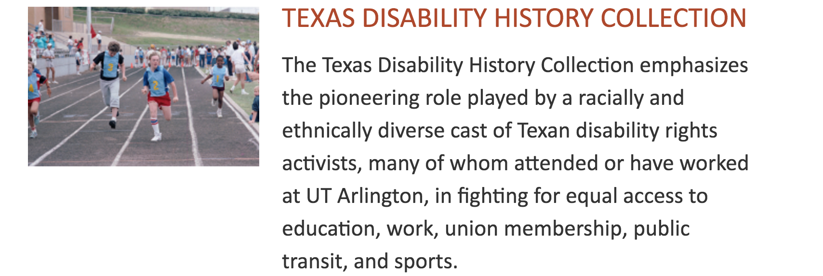
Success

Slide 11
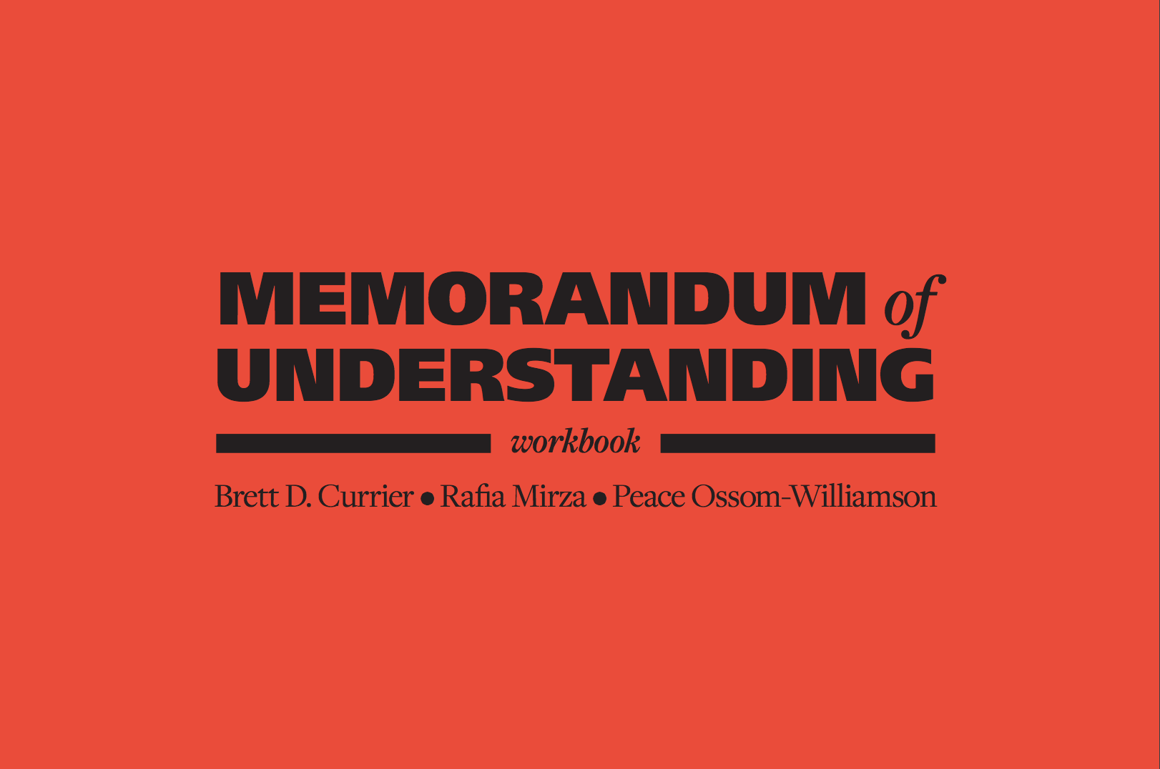
#utamou
http://bit.ly/utamou

Slide 12
What is an Memorandum of Understanding (MOU)?
“No matter their length or complexity, MOUs specify mutually-accepted expectations between two or more people or organizations as they labor together toward a common objective.”
“…generally they're not legally binding, in part because neither party wants to deal with the ramifications of a binding agreement, and they don't involve the exchange of money.”
“MOUs are less formal than contracts, … but they are more formal than handshake agreements…. All sorts of entities use MOUs to create guidelines for each party as they contribute their efforts and resources toward important projects. But ultimately, the reason that parties opt for MOUs is because they are simpler and more flexible than contracts.”
Nathan Chandler "How a Memorandum of Understanding Works" 9 May 2011. HowStuffWorks.com.
<http://people.howstuffworks.com/memorandum-of-understanding.htm> 21 July 2016

Slide 13
Workbook Contents
Introduction
MOU Documents
Workflow & Instructions
General Template & Instructions
Estimate of Institutional Support & Instructions
MOUs for Standardized Projects
  Systematic Reviews
  Open Access eJournal Hosting & Publishing

Slide 14
MOU Workflow
Notes:
Phase I - Library stakeholders: Talk to their supervisor. Consulted b/c long term plans of that department or the library
Phase II – Timelines/ Software Needs
Phase III - No major substantive change, getting final approval/sign off
Phase IV: No work started before now, documents in one place can become a template for your own institution

Slide 15

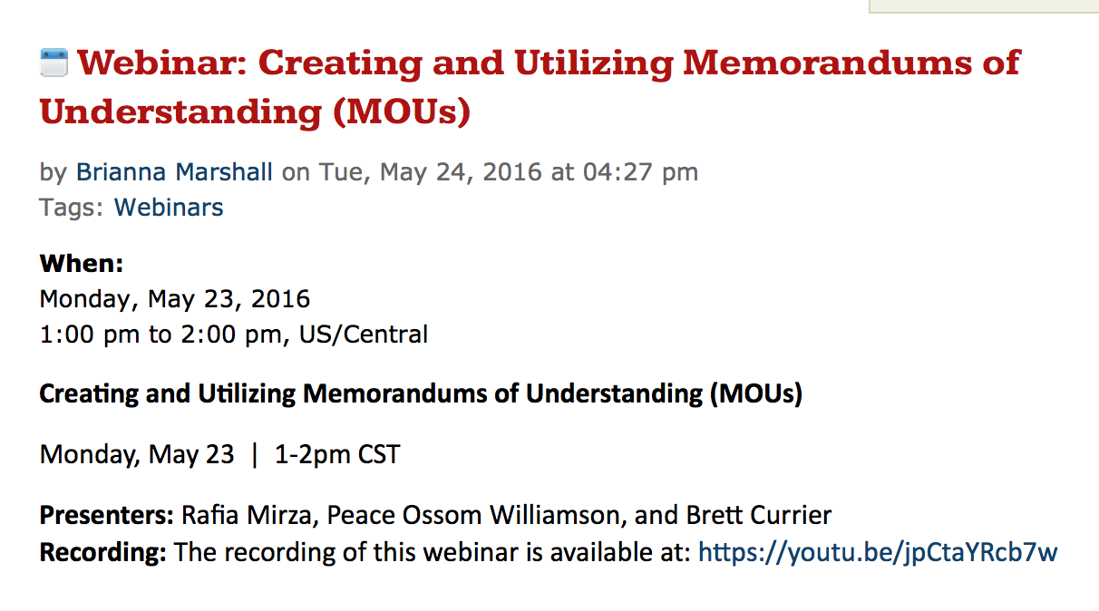
To access an archived 60 minute webinar (with chat transcript) done for the ACRL Digital Curation Interest Group, please click here

Slide 16
Jeff Downing
Digital Projects Librarian
downing@uta.edu
Rafia Mirza
Digital Humanities Librarian
rafia@uta.edu
This work is licensed under a Creative Commons Attribution-NonCommercial-ShareAlike 4.0 International License.

