Slide 1
Tips for helping faculty start an OJS Journal
By Susan Elkins

Slide 2
Vision for Journal
How are they going to get content?
Who will be running the journal?
How much do they want to customize?

Slide 3
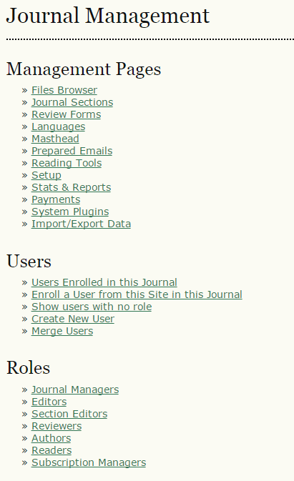
Roles: Journal Manager, Editor, Reviewer, Author
Technical Support
Set-Up

Slide 4
Explain the Setup Question
1.1 General Information
Journal title *
Journal initials
Journal Abbreviation
Print ISSN
Online ISSN
The ISSN (International Standard Serial Number) is an eight-digit number which identifies periodical publications as such, including electronic serials. A number can be obtained from the ISSN web site. This can be done at any point in operating the journal.
Mailing Address
The journal's physical location and mailing address.
1.2 Principal Contact
Name *
Title
Affiliation
Email *
Phone

Slide 5
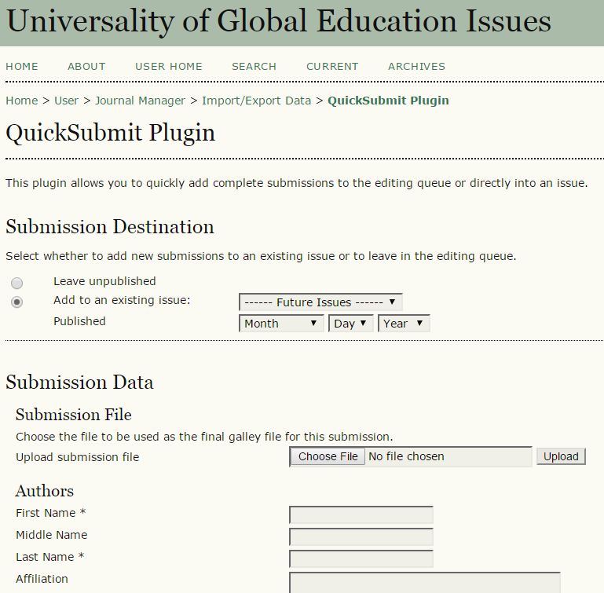
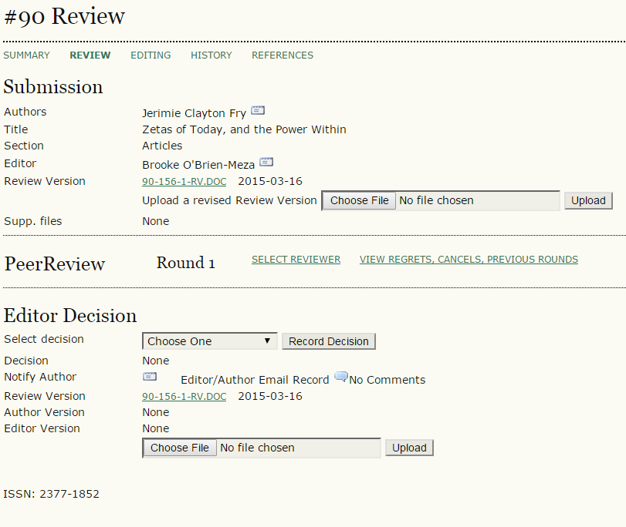
OJS Work Flow or Quick Submit Plugin

Slide 6
Access Points
Catalog with link website
Continue contact

