Slide 1
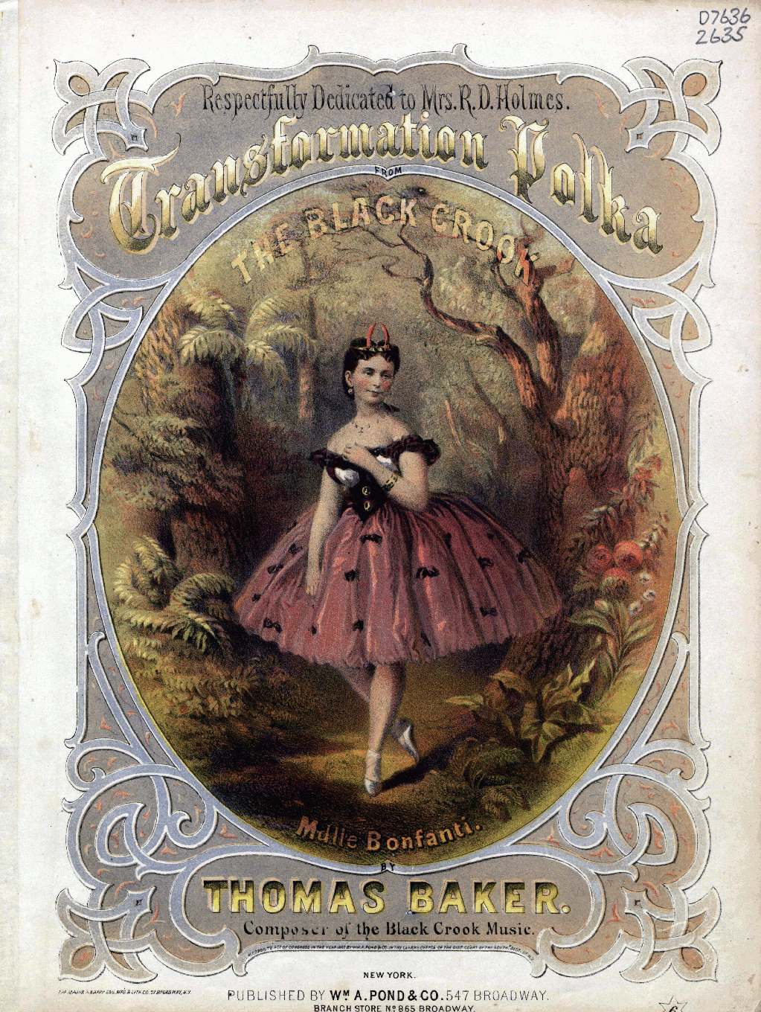
Fearless Transformation: Applying OpenRefine to Digital Collections
Kara Long
Catalog and Metadata Librarian
Baylor University Libraries
@thekaralong

Slide 2
Agenda:
The Spencer project
Re-examining the workflow
Implementing OpenRefine
Other uses for OpenRefine in digital collections

Slide 3
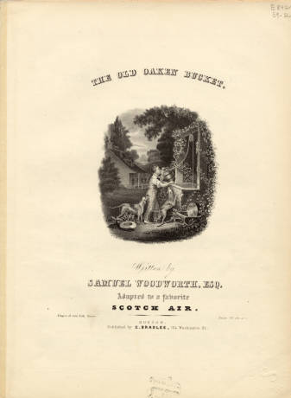
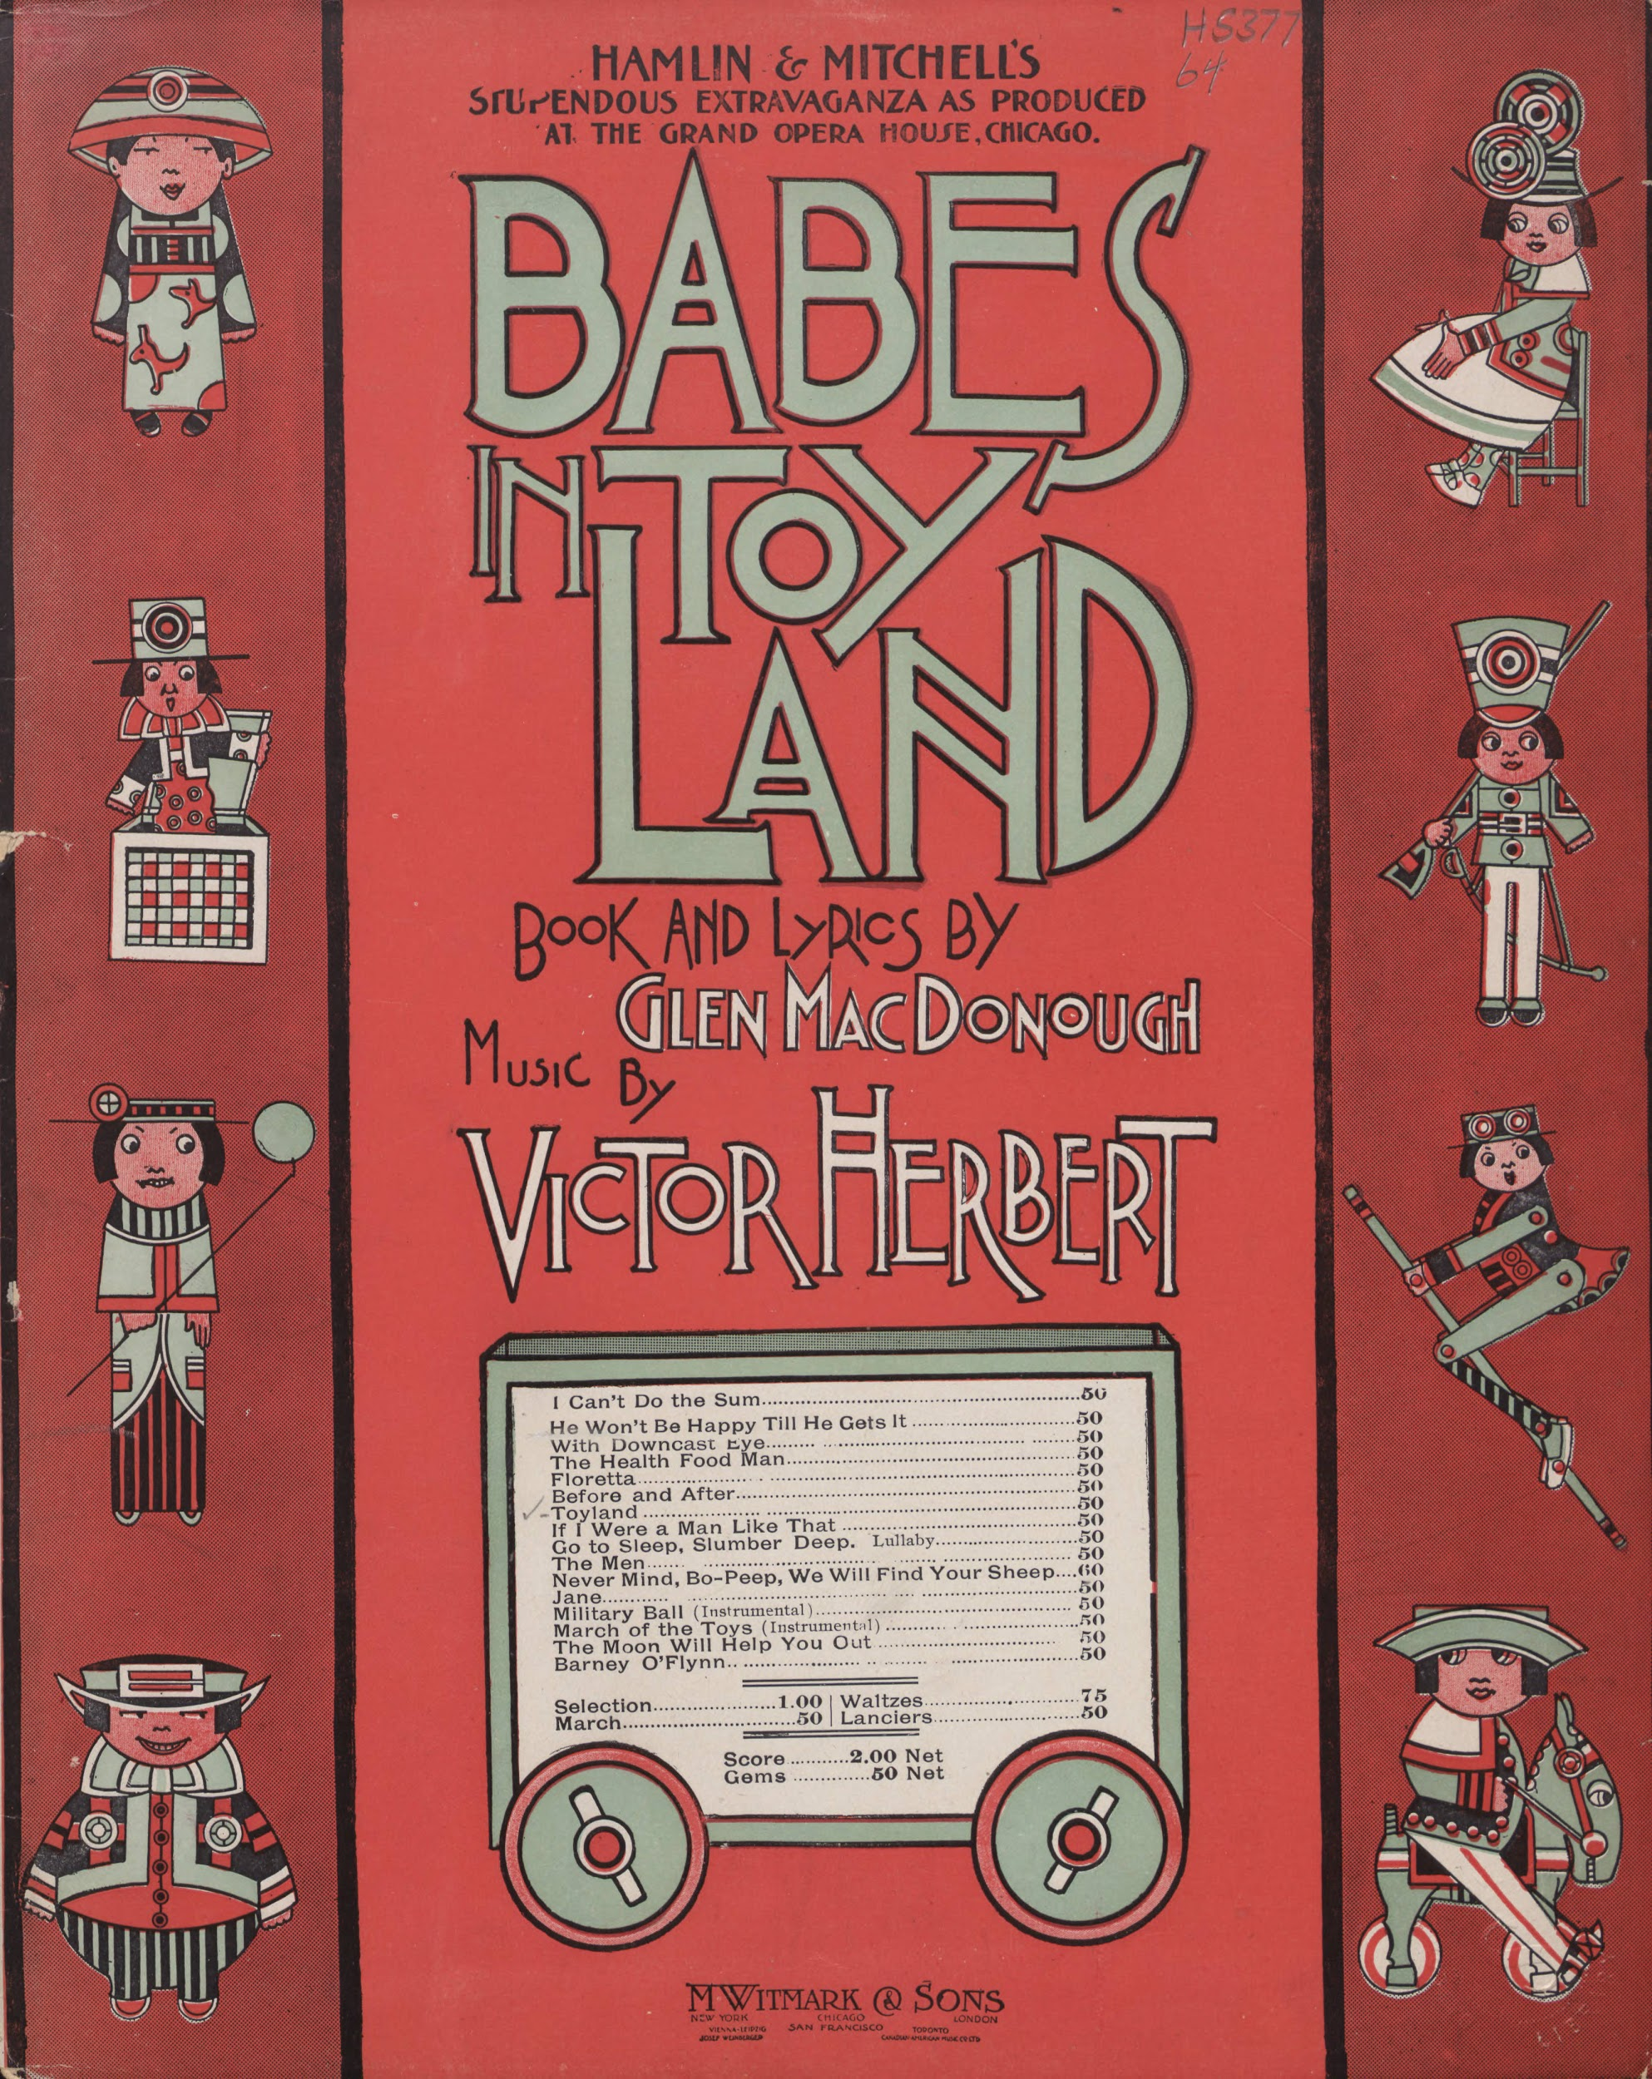
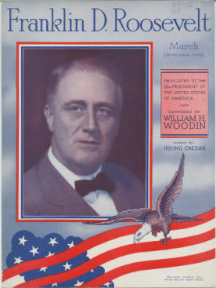
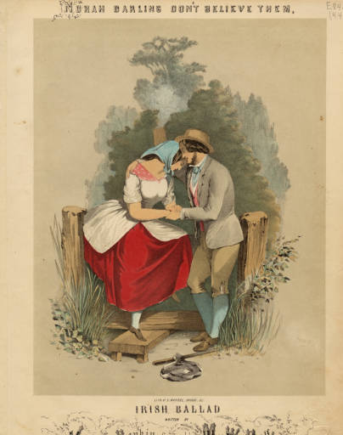
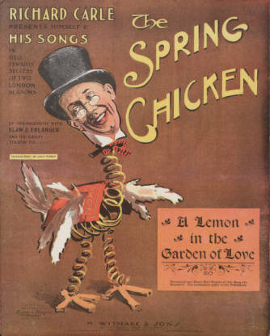
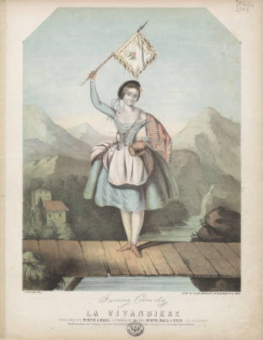
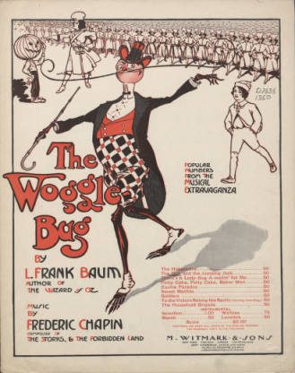
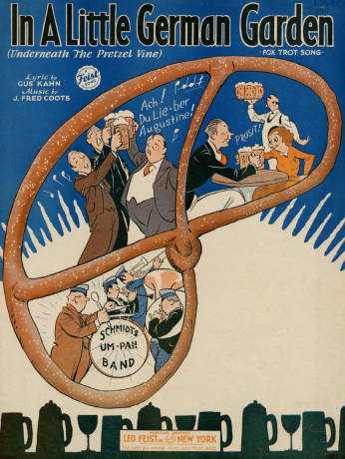
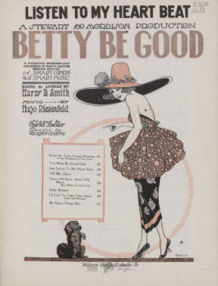

Slide 4
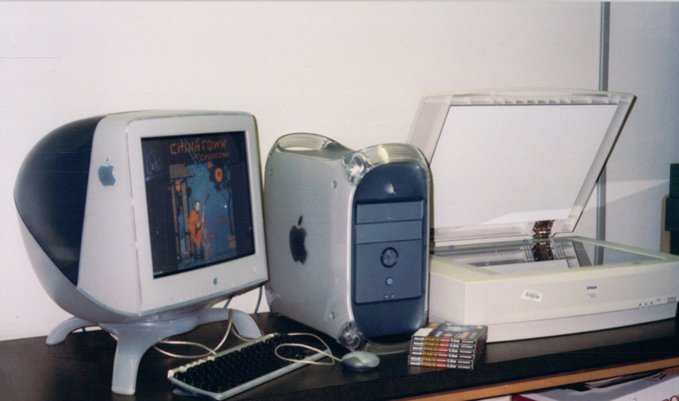
the Beginning
Project started in 1999
TexTreasures Grant to digitize 1,000 pieces
Descriptive metadata loaded into ILS
Static HTML was programmatically generated and placed on server

Slide 5
Adding Partners
Notes:
That completed the phase
2003 - Moved to CDM
Started back up in CDM
---------
30/month; an obvious metadata bottleneck (77 years to complete the project)
2008: Flourish outsourced music cataloging

Slide 6
the Workflow
Notes:
To set up outsrc
[workflow]
Catalog: send you an XML
300-line PERL script
TSV
This many parts -- BUGGY
2013 - Personnel change Kara
Do we continue...XSLT...PERL
OpenRefine at a TCDL post-conference workshop
OpenRefine has taken us from this to...

Slide 7
the Workflow Revised
Notes:
Direct to TSV
CDM ready
Transformations take place by MD group, not programmers.
Efficient, fast.
Hand it over to Kara to discuss the OpenRefine process in more detail.

Slide 8
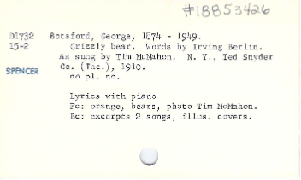
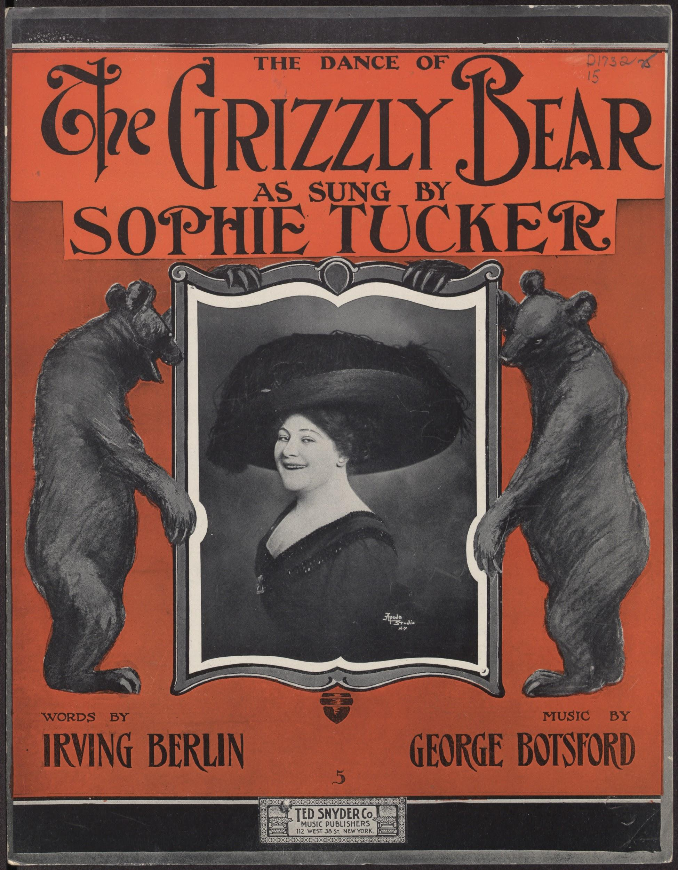
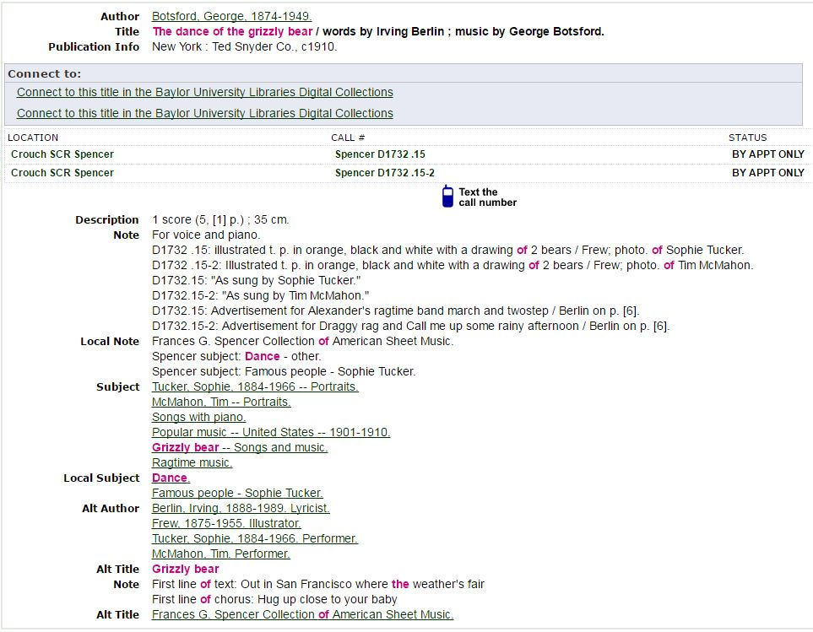

Slide 9
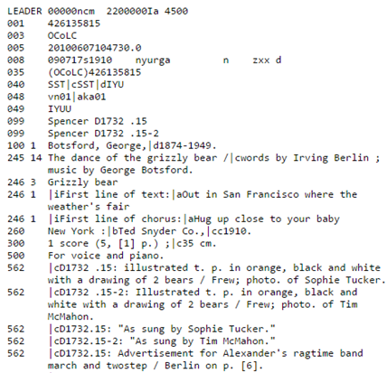
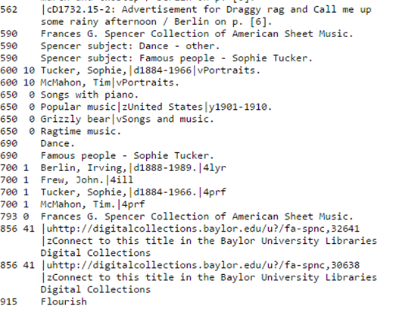
MARC

Slide 10
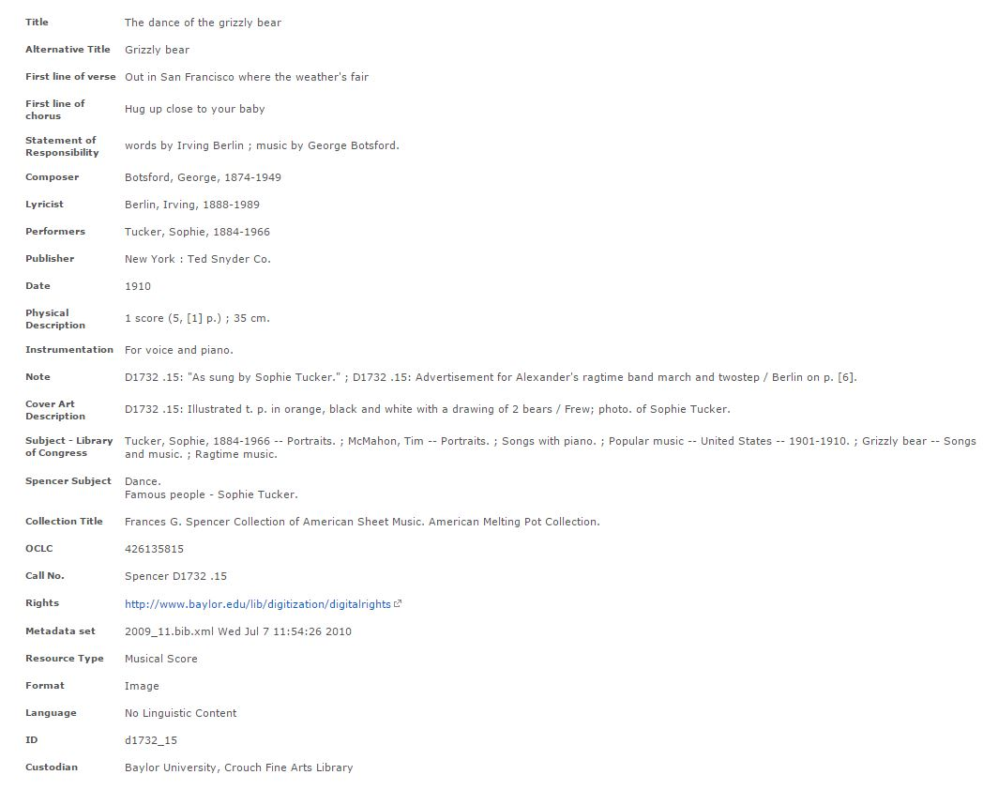

Slide 11
of Data Loss!

Slide 12
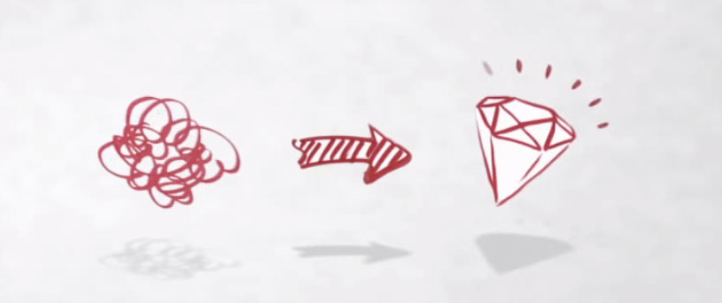
OpenRefine
Interactive Data Transformation tool (IDT)
Open source
Runs locally
Interactive like a spreadsheet - but more powerful
Programmable like a database - but more exploratory

Slide 13
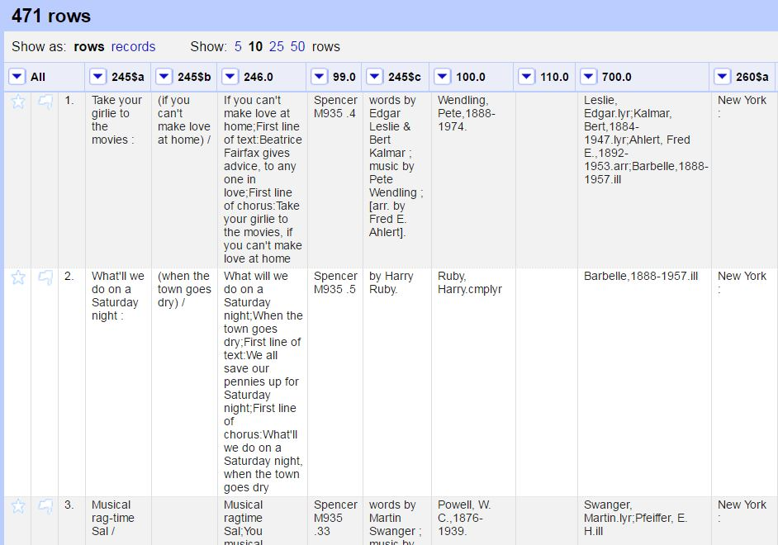
OpenRefine
Creating a new project
Rename and reorder MARC fields
Join values
Split values
Re-format dates
Remove unnecessary punctuation, delimiters, etc.
Add new fields for the digital collection

Slide 14
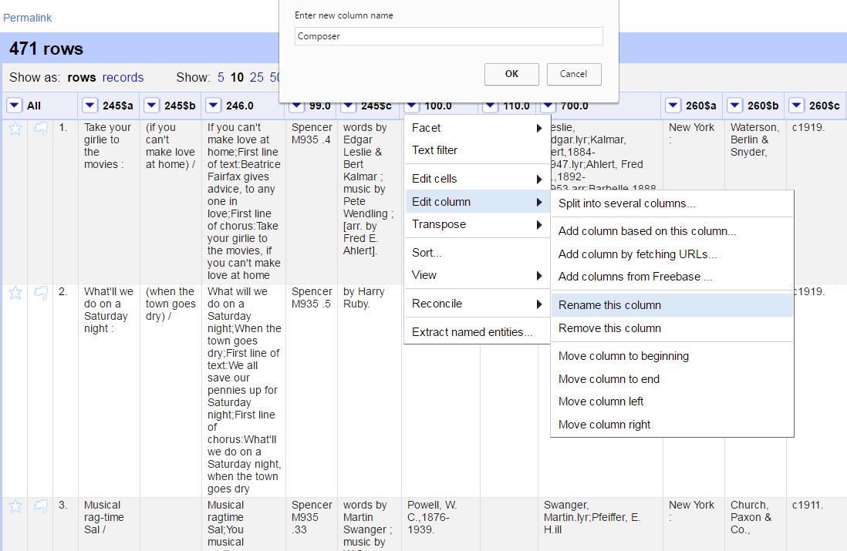
Renaming columns
OpenRefine
Columns are the primary units of interaction.
Column names must exactly match our CDM field names in order for upload the metadata.
MARC 100 → Composer

Slide 15
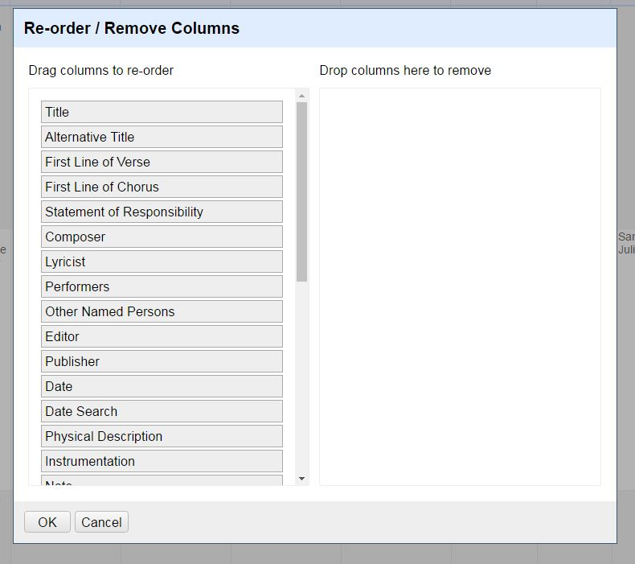
Re-ordering columns
OpenRefine
Once all the fields have been re-named, they can be re-ordered under the All columns menu.

Slide 16
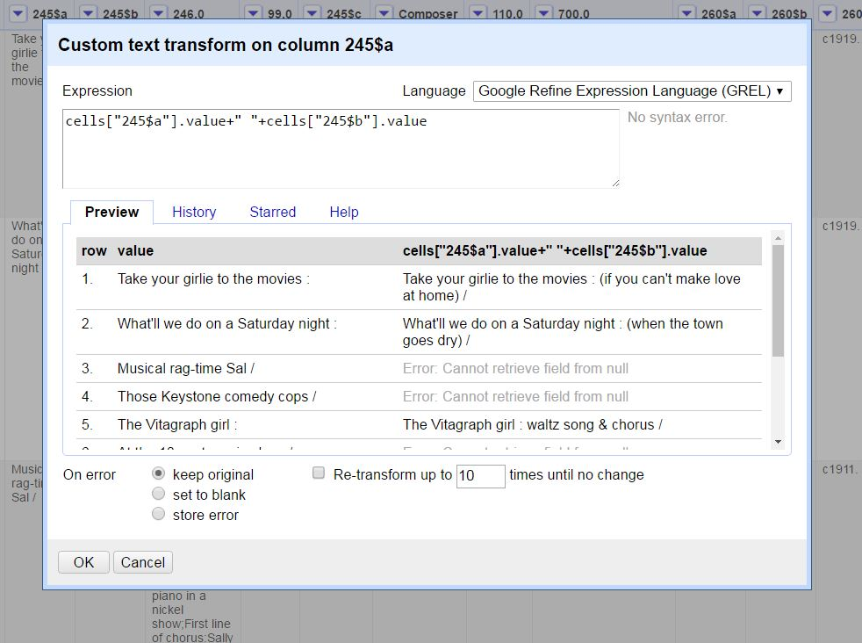
OpenRefine
Joining Values
Transform data with Google Refine Expression Language (GREL)
Joining the 245$a and 245$b to create the Title field

Slide 17
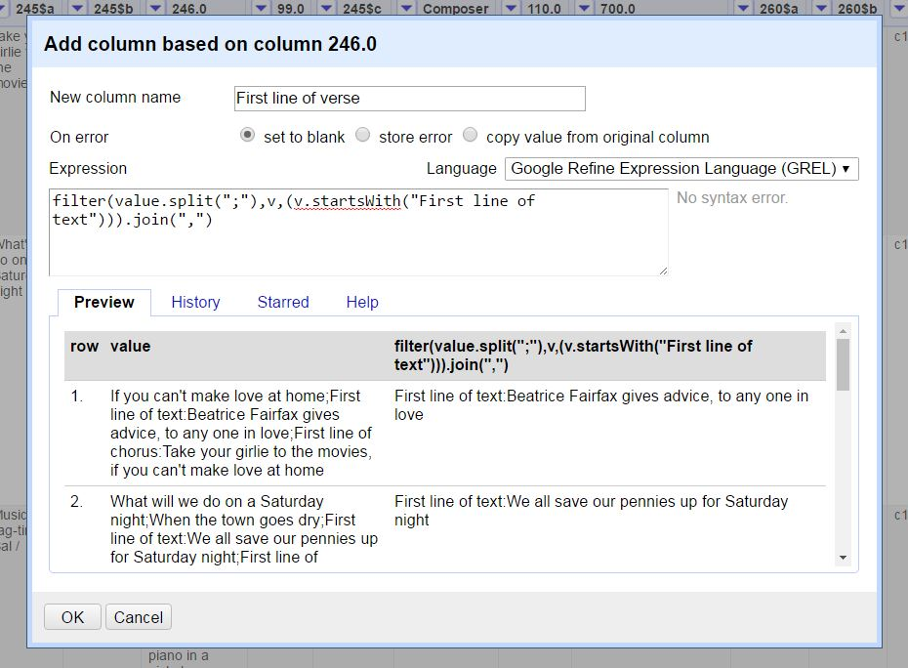
OpenRefine
Splitting values
The 246 must be split into two or three fields:
Alternative Title
First line of verse
First line of chorus

Slide 18
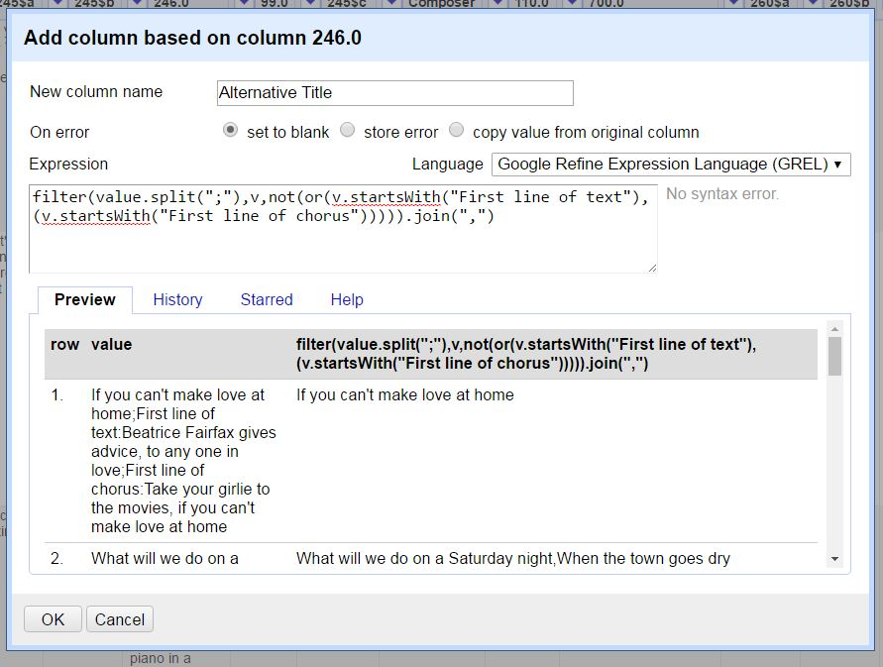
OpenRefine
Splitting values
Know your data!

Slide 19
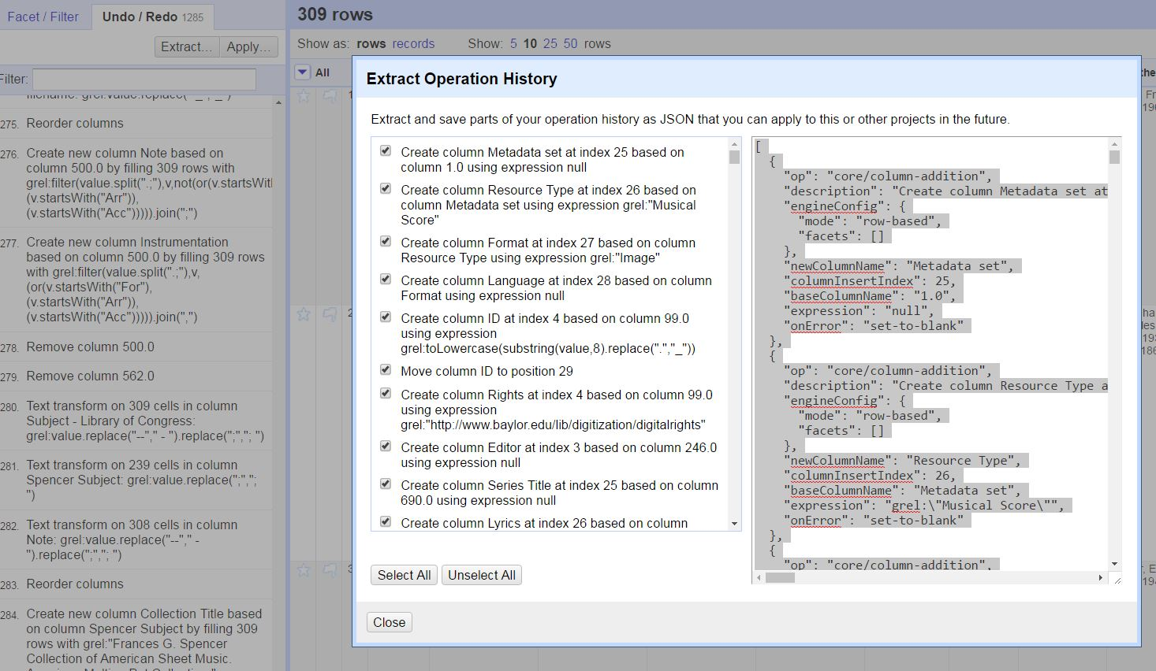
OpenRefine
Extract and save operation history

Slide 20
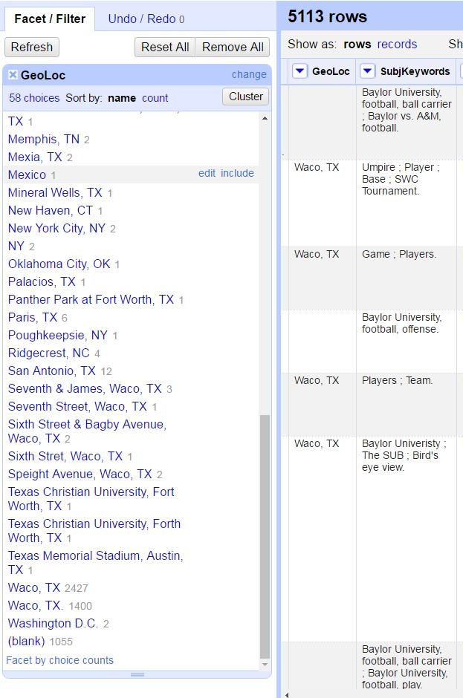
OpenRefine
Identifying clean up in existing CONTENTdm collections
Text faceting
Custom text facets
Identifying duplicates

Slide 21
Invaluable Resources
http://openrefine.org/
http://freeyourmetadata.org/
https://github.com/OpenRefine/OpenRefine/wiki/GREL-Functions
Verborgh, Ruben, and Max De Wilde. Using OpenRefine. Birmingham: PACKT Publishing, 2013.
Van Hooland, Seth, and Ruben Verborgh. Linked Data for Libraries, Archives, and Museums: How to Clean, Link, and Publish Your Metadata. Chicago: Neal-Schuman, 2014.

